Slide 1
The Last Month in InfoSec July 2015 Edition
Joe T. Sylve, M.S.
NOLASec
July 15, 2015

Slide 2
Disclaimer
The views expressed during this talk (and in general after drinks) are mine alone and do not necessarily reflect those of Blackbag Technologies or 504ENSICS Labs.
They may or may not also be shared by Vico and Andrew (but who cares what those guys think?)

Slide 3

Grab a Copy of These Slides
https://github.com/jtsylve/slides

Slide 4
Hacking Team
So many goodies…

Slide 5
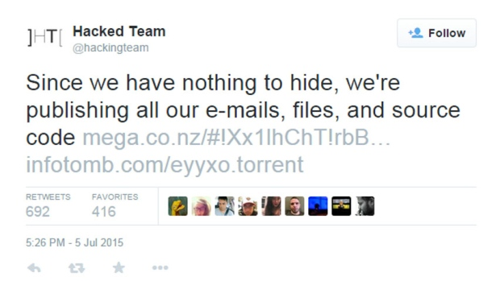
Hacking Team Hacked

Slide 6
Hacking Team Hacked
University of Toronto Report (July 2014)
https://goo.gl/a0J8gC
Over 400 GB of Data Released
https://infotomb.com/eyyxo.torrent
https://github.com/hackedteam
https://wikileaks.org/hackingteam/emails

Slide 7
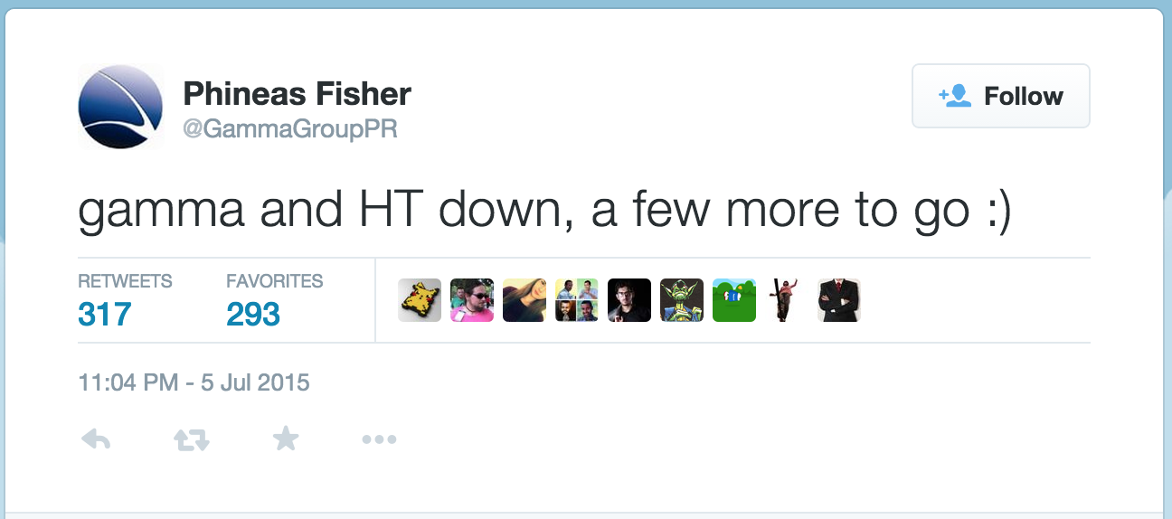
Hacking Team Hacked

Slide 8
Hacking Team Hacked
Several 0day have already been discovered and are actively being used in the wild
Flash (more than one)
IE 11
Office
Java
There will be more…

Slide 9
Hacking Team Hacked
UEFI Rootkit Used for Persistence
Rootkit: https://goo.gl/kCLdGS
Powerpoint: https://goo.gl/j7sOqF
Intel Write-up: https://goo.gl/iQqrDp

Slide 10
In Other News
… but wait there’s more!

Slide 11
In Other News
Another High Severity OpenSSL bug found
https://goo.gl/fO8NBH
FBI is still lobbying Congress to mandate encryption backdoors
Full Senate Hearing: http://goo.gl/JB3zUX
No SSL link available (Thanks senate.gov!)
Experts Outline Risks: https://goo.gl/kVDa3s
Bruce’s Thoughts: https://goo.gl/KyHkD5

Slide 12
In Other News
Amazon releases new TLS library: s2n
Only 6,000 LoC
Annoucement: https://goo.gl/nBhaQG
Source: https://github.com/awslabs/s2n
RIPv1 DDoS Attack
Outdated Routing Protocol
Akamai Advisory: https://goo.gl/pZiuJo

Slide 13
In Other News
Many Cisco Appliances Use Default Hardcoded SSH Keys
https://goo.gl/PV0Kau
They’re not the only ones…
https://github.com/rapid7/ssh-badkeys

Slide 14
That’s All for Now!
Thoughts?
Questions?
Comments?
joe.sylve@gmail.com
@jtsylve
https://github.com/jtsylve/slides

